Slide 1
Travel Website
SUBJECT : WEB APPLICATION DEVELOPMENT USING PHP AND MYSQL
Group Members: JASMEET KAUR SAINI (C0738053)
NAVPREET KAUR(C0743994)

Slide 2
CONFIGURATION
SOFTWARE USED : XAMP, BRACKETS and ATOM
HARDWARE USED : MAC OSX
FRONT END LANGUAGE : PHP HYPERTEXT PREPROCESSOR
BACK END LANGUAGE : MYSQL
OTHER SCRIPTING LANGUAGE : JAVASSCRIPT, CSS, HTML

Slide 3
FEATURES
General features :
Session Management
Account Management (Admin, Customer)
Twilio Integration for Sending Text Messages
Paypal Integration for making payment using credit card
Customer features :
Account Creation - Login, Signup, Change Password, Logout
SMS Reminder
Book a room by date
Email confirmation by booking
View Details of a room

Slide 4
Cont’d…
Admin Features :
Content Management Features
Allow admin to change static content on a page
Account Management
CRUD on USERS
Add User, Edit User, Delete User, View User
Managing Rooms
Add Room, Edit Room, Delete Room, View Room

Slide 5
ADMIN Side

Slide 6
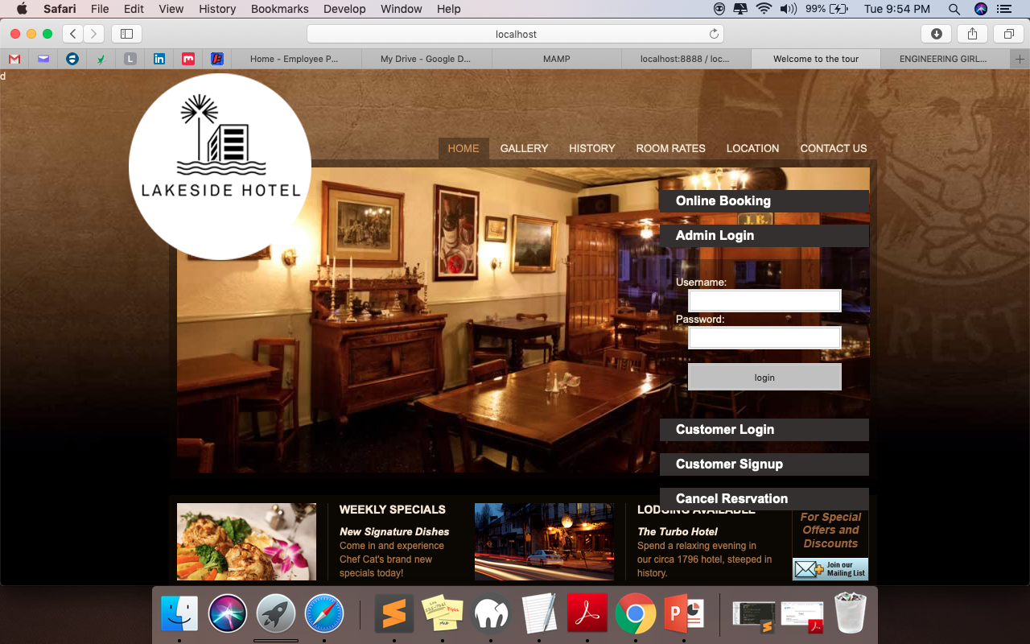
LOGIN PAGE Admin can login to the site to see the database.

Slide 7
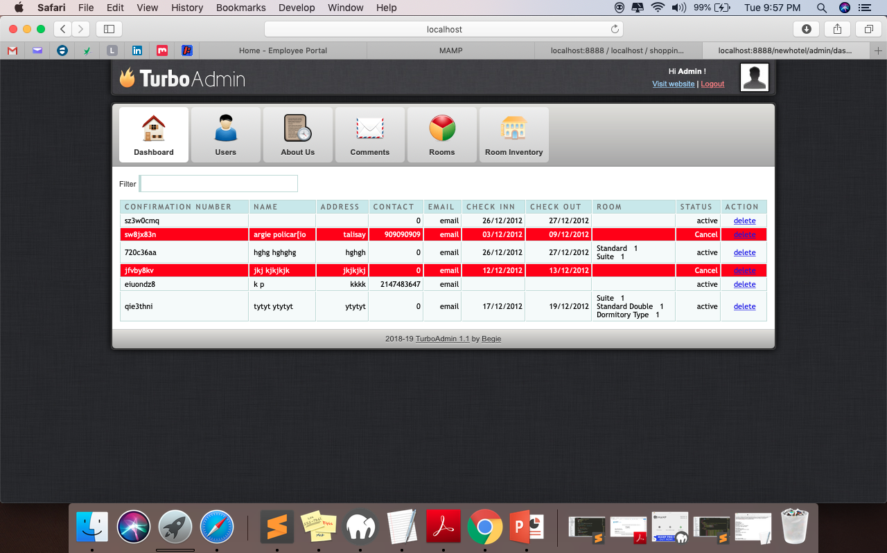
HOME PAGE Shows the registered users.

Slide 8
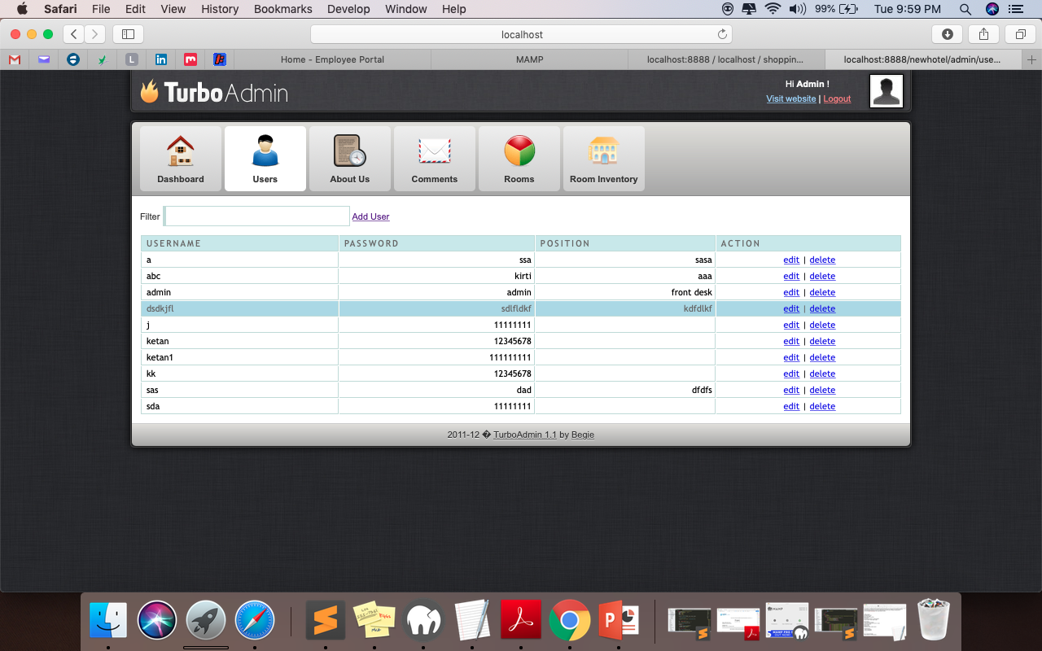
User Management Manages admin side users.

Slide 9
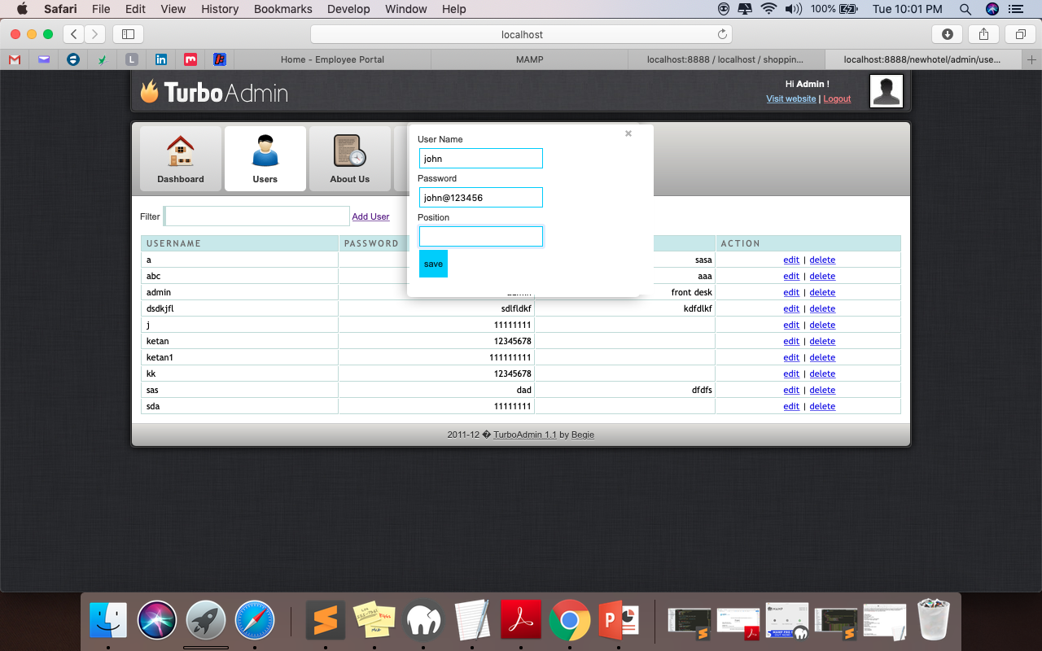
Add User Adds the admin side users for the management purpose.

Slide 10
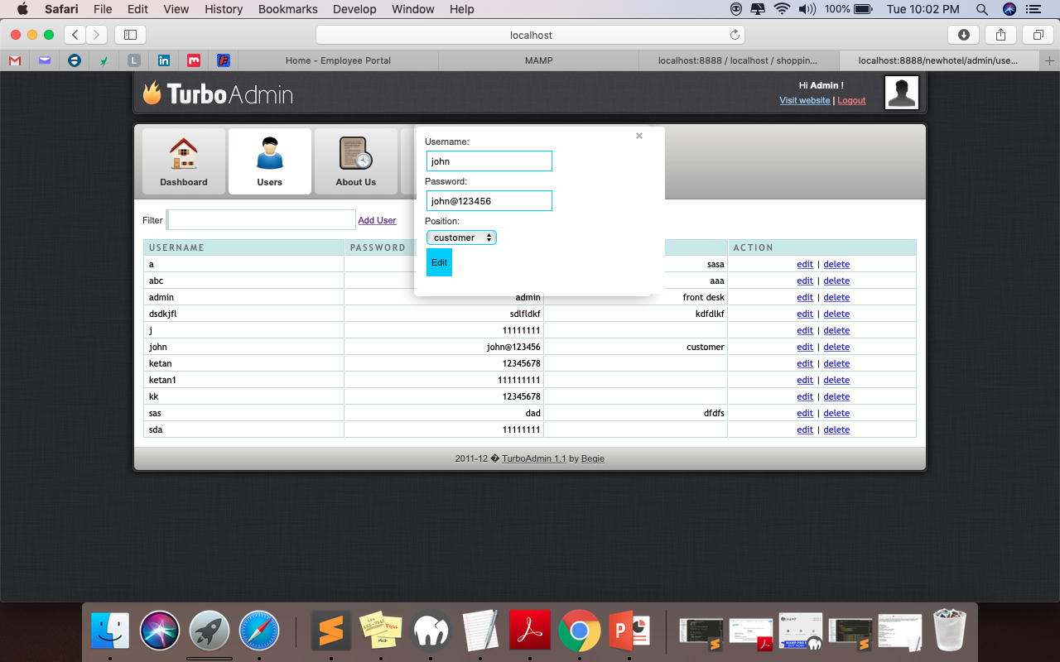
Edit / Delete User Can edit and delete the user.

Slide 11
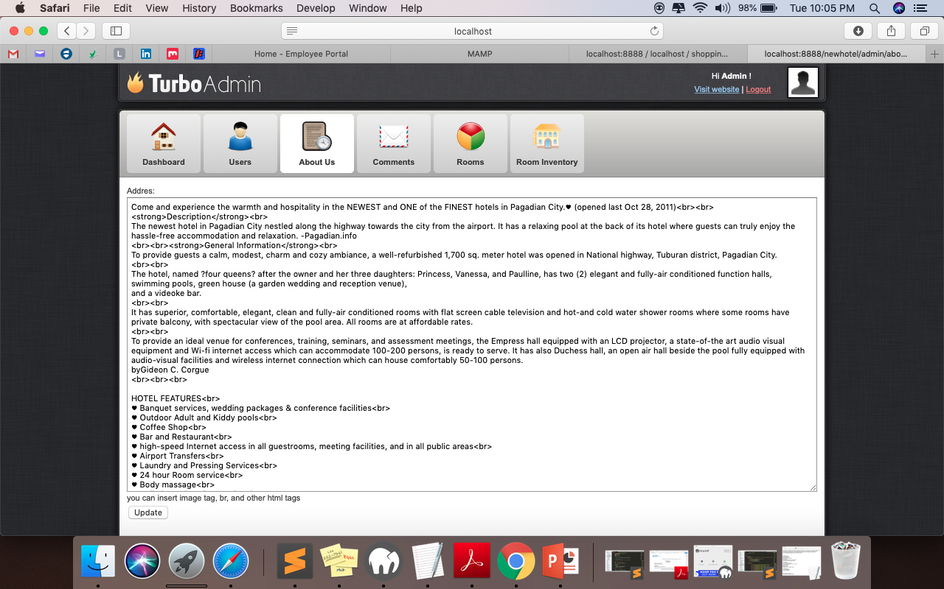
Content Management (About US) Admin can update the history.

Slide 12
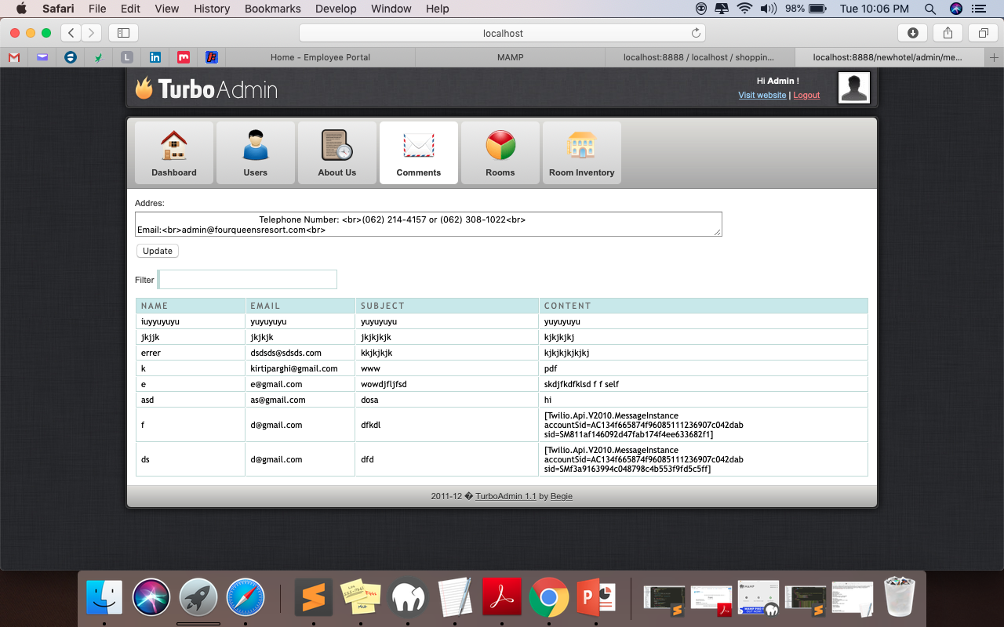
Comments Screen Shows the information of the customers who wanted to inquire about the booking or any other stuff.

Slide 13
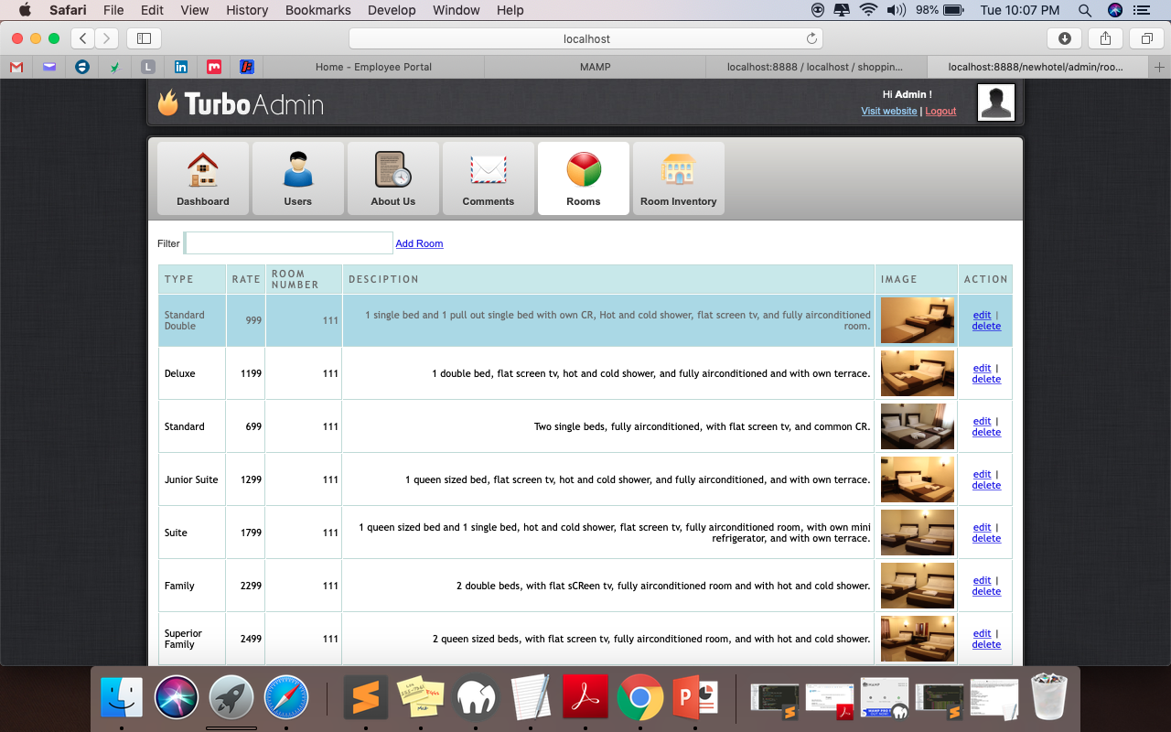
Room Management Admin can add, edit or delete the room details.

Slide 14
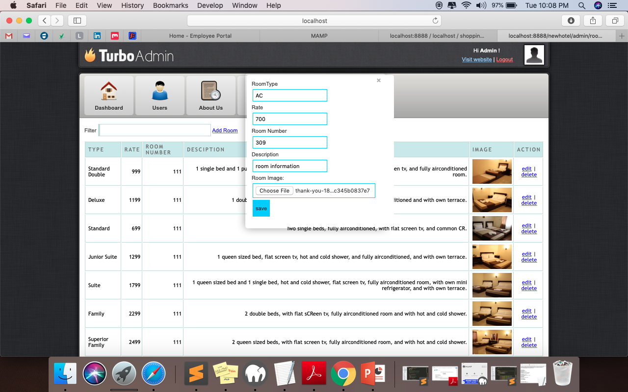
Add Room

Slide 15
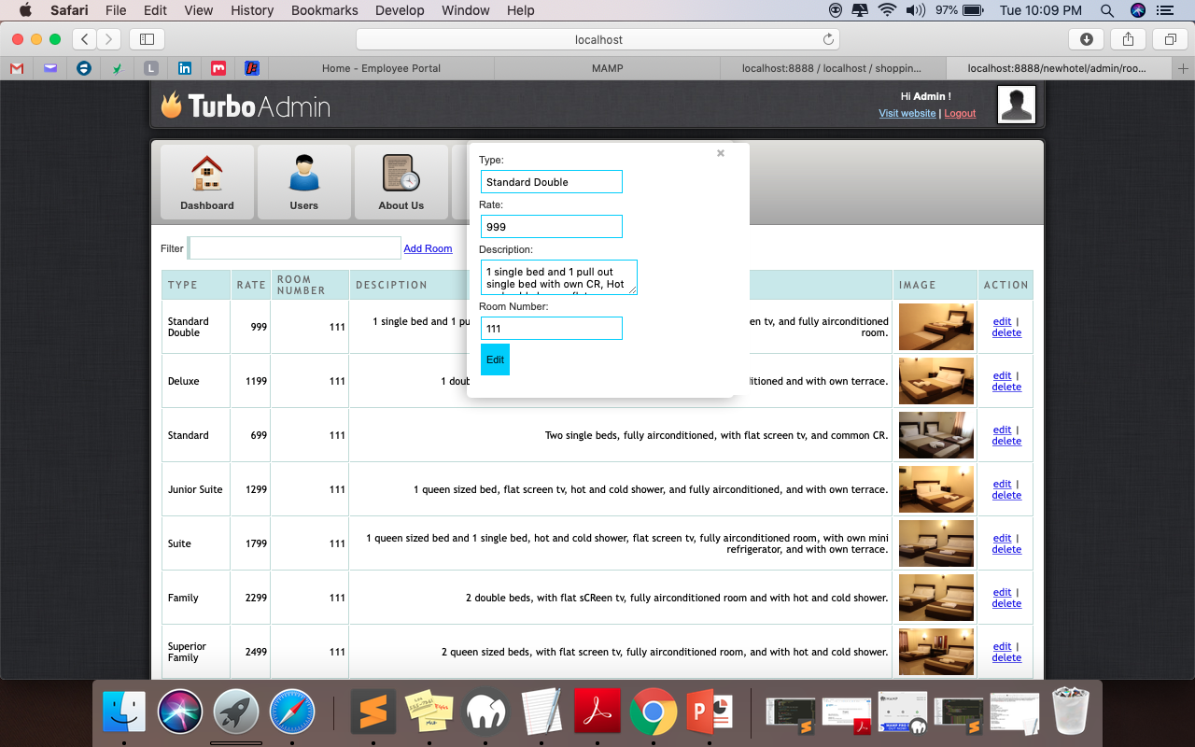
Edit Room

Slide 16
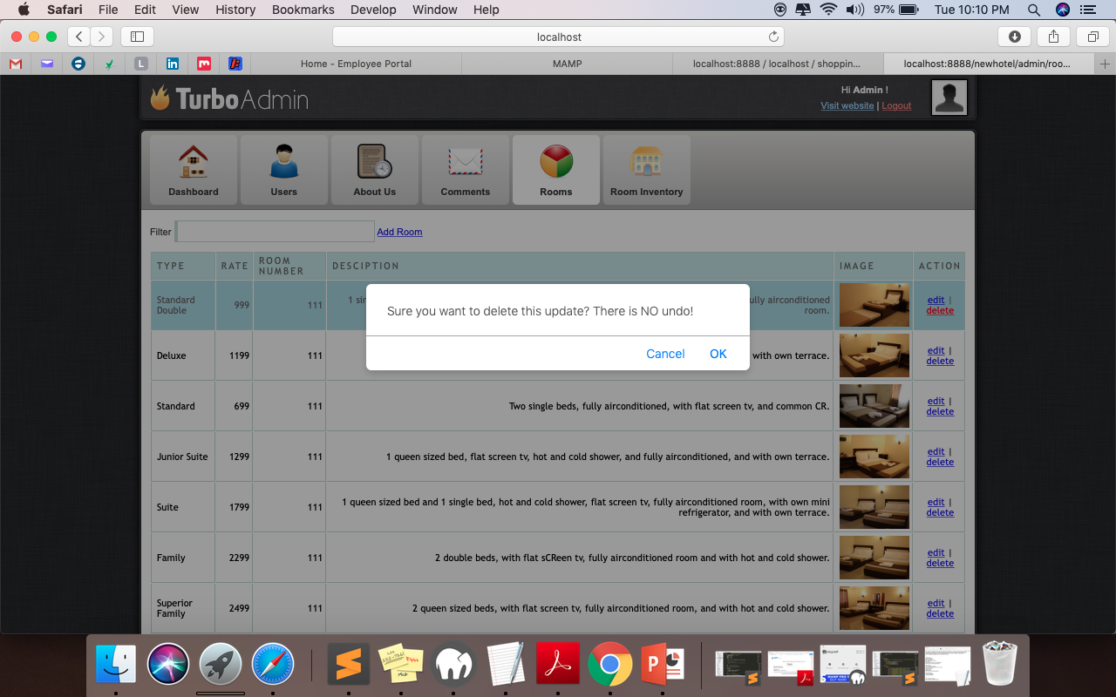
Remove Room

Slide 17
Customer Site Screenshots

Slide 18
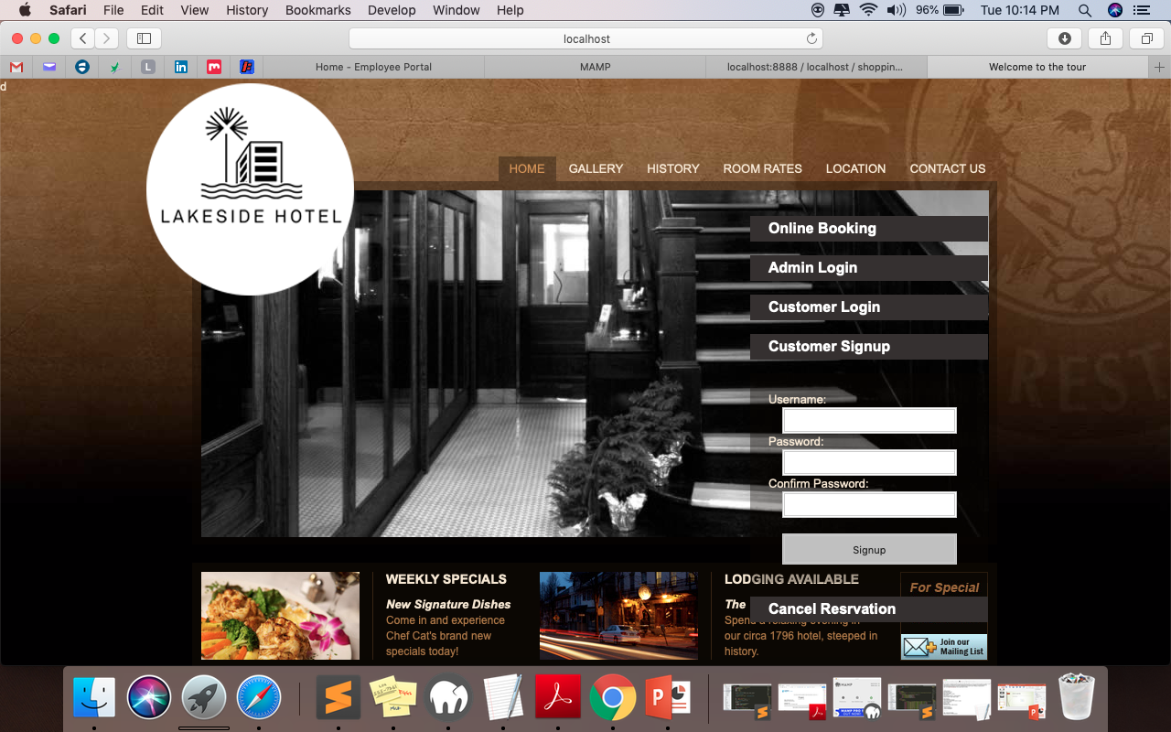
Sign Up New user can sign up.

Slide 19
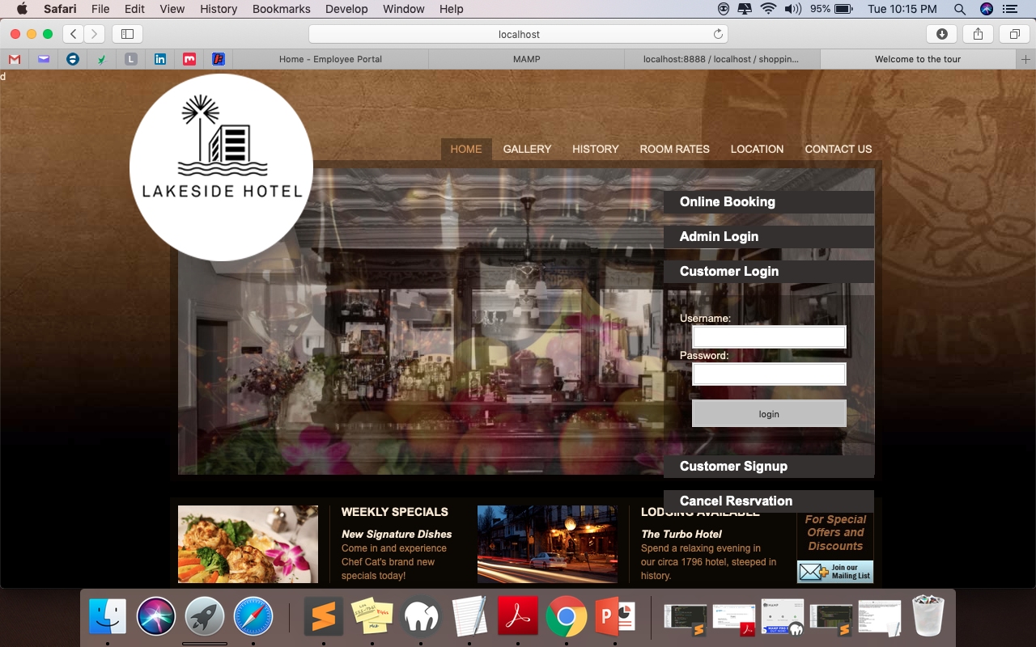
LOGIN Customer could login to the website to book the room or cancel it.

Slide 20
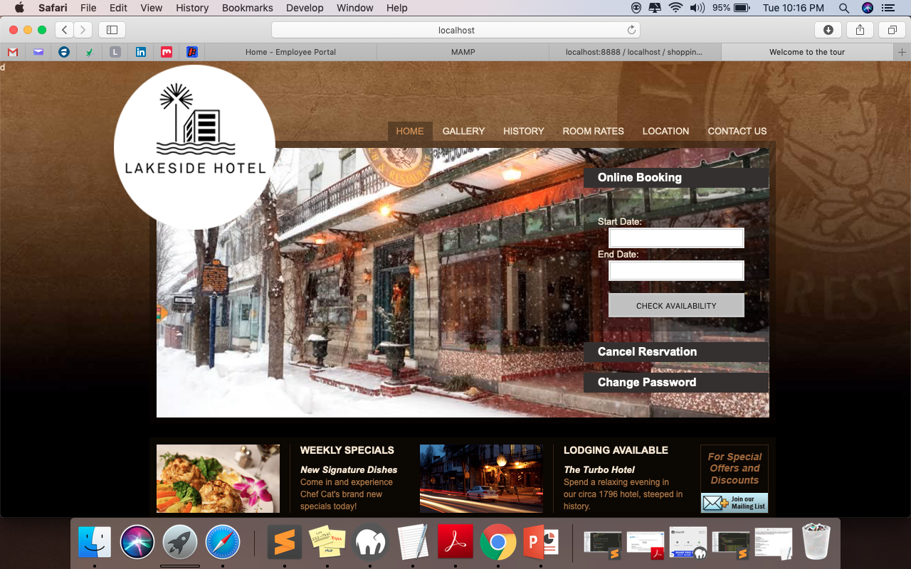
Home Page After selecting the dates, customer will check the availability.

Slide 21
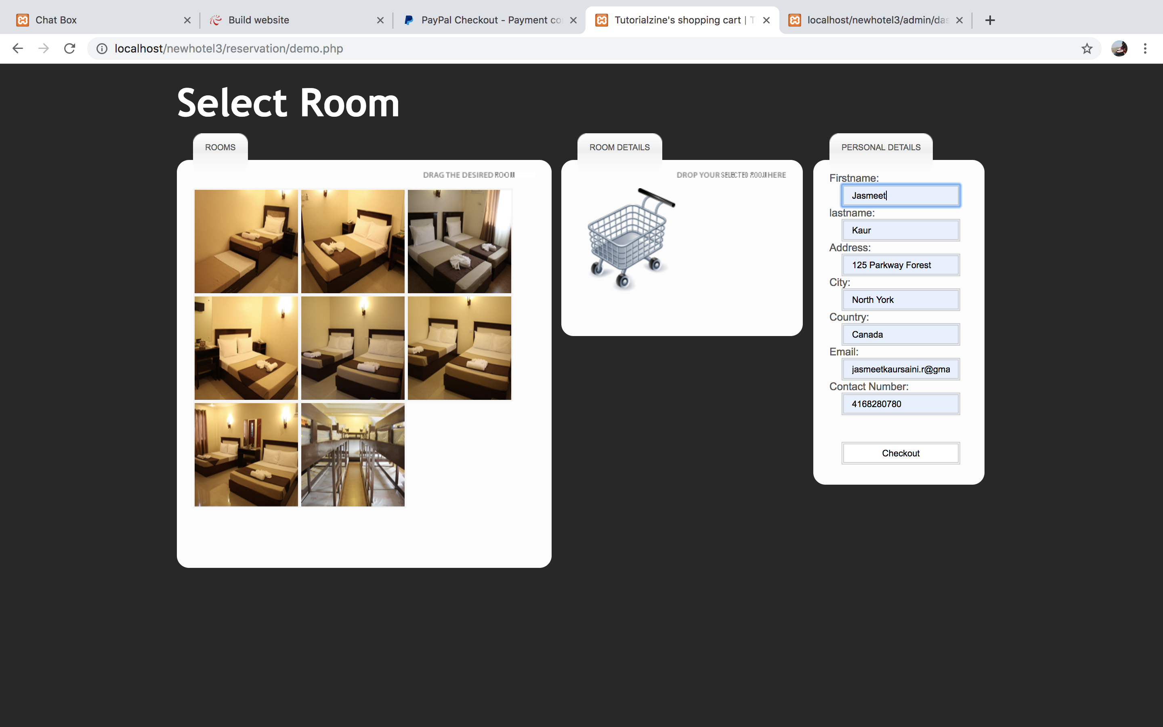
Sign Up Customer will select the category of the room and continue checkout.

Slide 22
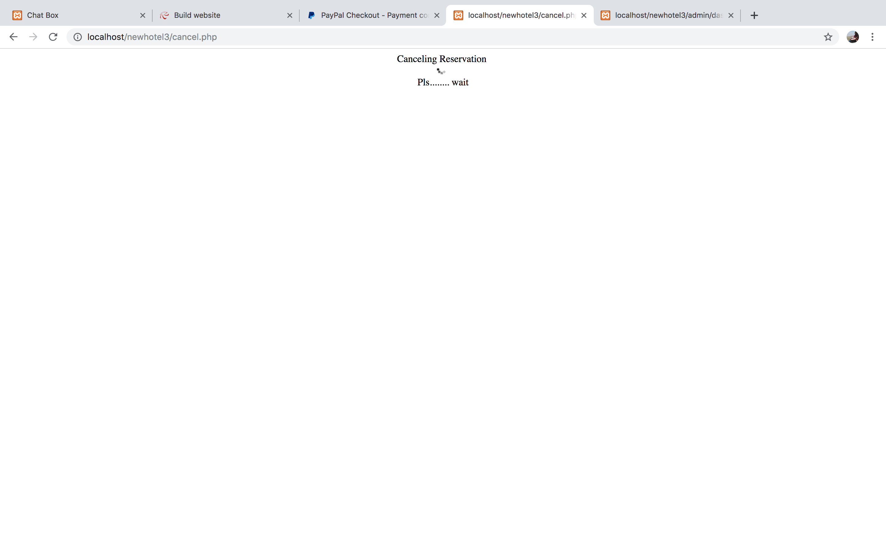
Cancel reservation With the confirmation number, he can cancel the reservation.

Slide 23
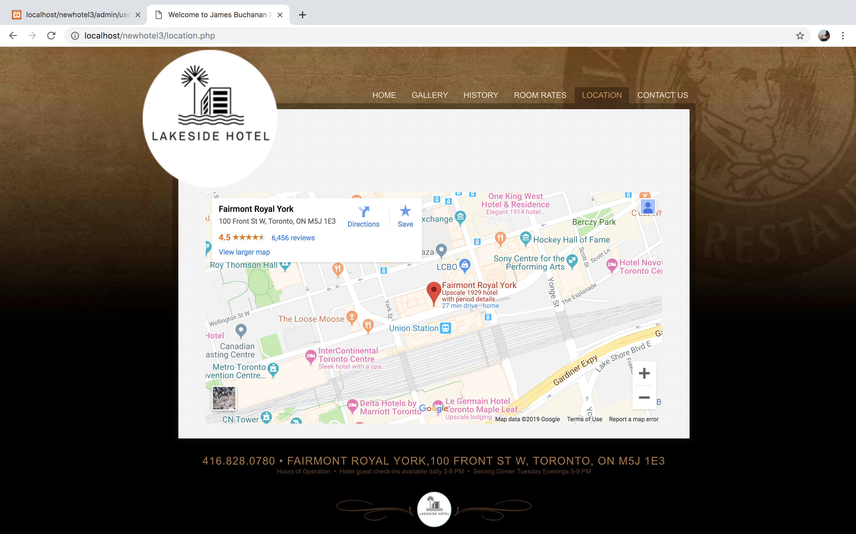
Customer can search for the location of the hotel.

Slide 24
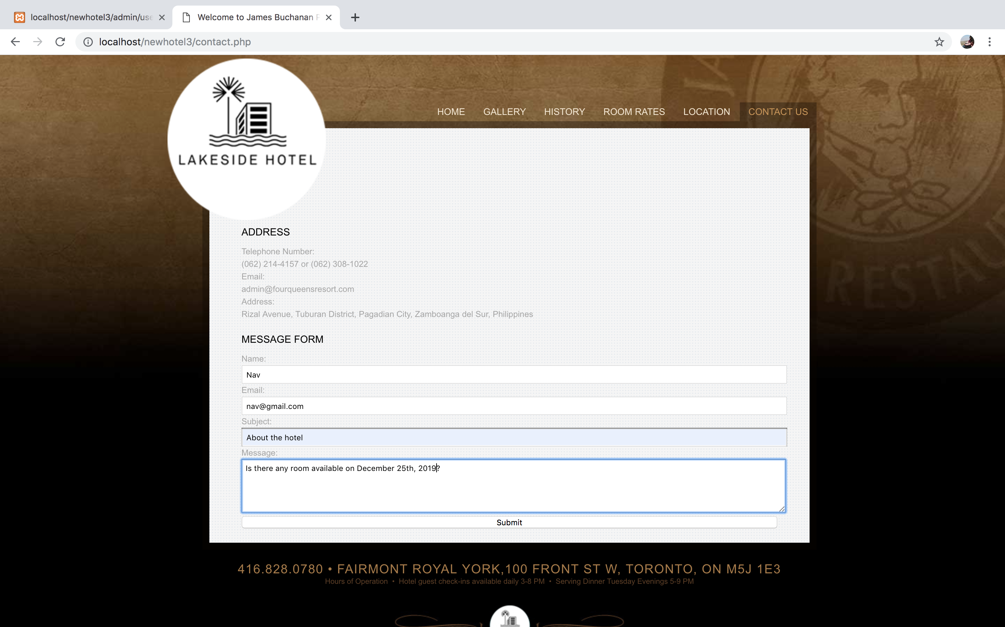
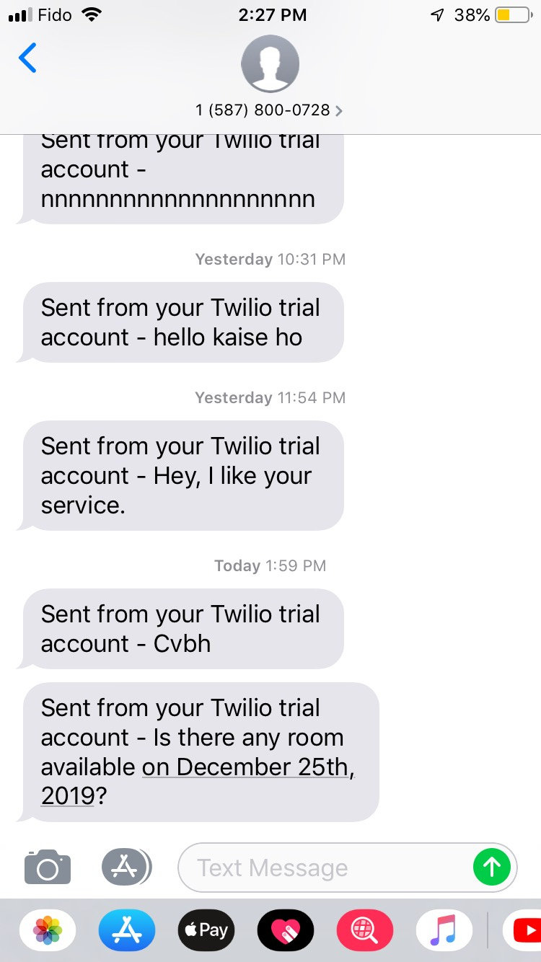
Customer could send the message to the admin.

Slide 25
Hosting link for the website.
https://bit.ly/2V4kFUP

Slide 26


